Slide 2
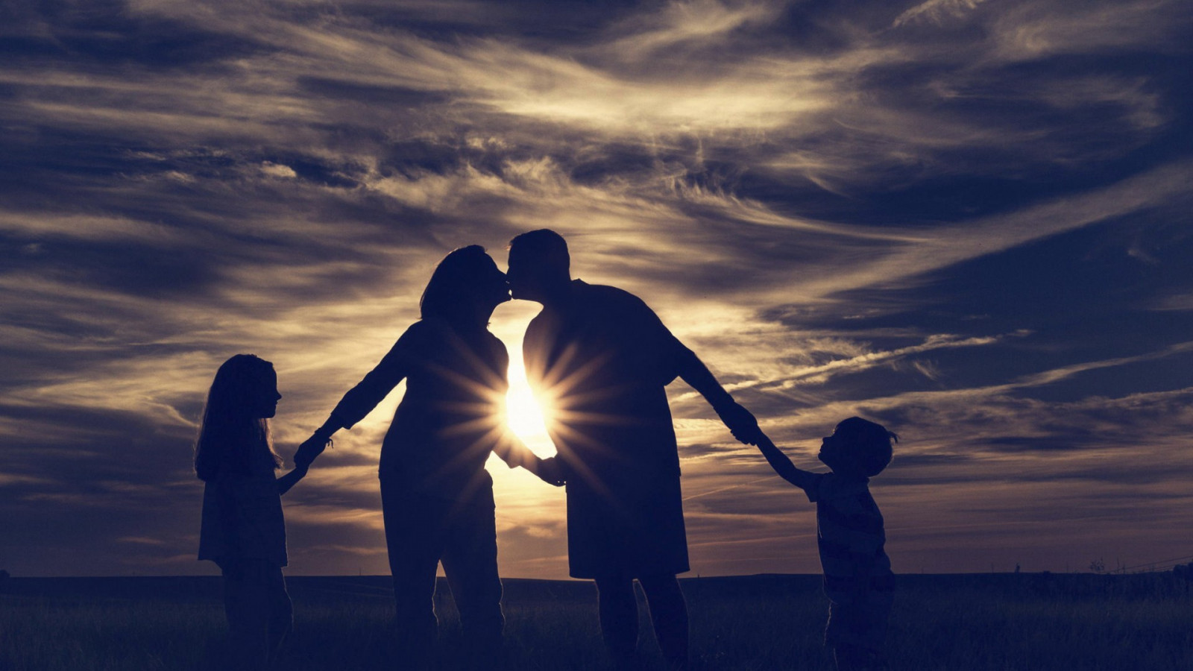
Harmony and Happiness in the Home

Slide 3
In the home where…
Love abounds
Peace prevails
Impartiality is shown to all
Order is maintained
Roles are respected

Slide 4
In the home where…
Discipline is carried out
Basic spiritual principles are taught
True Christianity is practiced

